Slide 1



Credit Scoring System
Artificial Neural Network

Slide 2

Team Members
G S Nihal Razak (RA2211026010451)
R .Sudarshan (RA2211026010466)
Sargurusaran (RA2211026010446)
Naveen K (RA2211026010462)

Slide 3




Introduction
Literature Survey
Objective
Agenda
Modules
Architecture and Design
References

Slide 4
Introduction
A credit scoring system based on Artificial Neural Networks (ANN) is designed to evaluate the creditworthiness of individuals or businesses by analyzing various financial and behavioral attributes. Traditional credit scoring methods, such as those based on logistic regression or rule-based systems, rely on predefined statistical relationships, but these can be limited in flexibility and accuracy. ANN, on the other hand, offers a more sophisticated and adaptive approach that can learn complex patterns in large datasets, making it particularly suited for credit scoring applications where multiple nonlinear relationships exist. In a credit scoring system, the input typically includes a variety of financial and demographic features, such as income, loan amounts, credit history, debt levels, employment status, and even payment behavior. These features are fed into the neural network, which processes them through layers of interconnected nodes that mimic the human brain's neural activity
Challenges:
Interpretability: Neural networks are often considered black-box models, making it difficult to interpret the decision-making process.
Data Quality: ANN performance depends heavily on the quality of the input data. Missing or biased data can lead to inaccurate credit scoring.
Overfitting

Slide 5

Literature Survey
A literature survey in credit scoring systems explores the various approaches, methodologies, and models that have been used over time to assess credit risk. This includes the evolution from traditional statistical models to more advanced machine learning and Artificial Neural Networks (ANN), highlighting both the strengths and limitations of each approach. Below is a comprehensive overview of key findings and methodologies from the literature on credit scoring systems.
1. Traditional Credit Scoring Models:
Logistic Regression: Historically, logistic regression has been one of the most widely used models for credit scoring. It is simple, interpretable, and provides probabilistic estimates. Early studies, such as those by Thomas et al. (2002), demonstrated the efficacy of logistic regression in distinguishing between creditworthy and non-creditworthy individuals based on linear relationships between variables like income, debt levels, and credit history.
Discriminant Analysis: Another early technique, discriminant analysis, as described by Altman (1968), was frequently applied to assess credit risk by identifying a linear combination of features that separates different credit classes. However, it was limited by its assumption of multivariate normality and equal covariance matrices across classes.

Slide 6
3. Machine Learning Models:
Support Vector Machines (SVM): With the advent of machine learning, SVM emerged as a robust method for credit scoring. Gestel et al. (2005) demonstrated the effectiveness of SVM in handling non-linear relationships and high-dimensional data. SVM, with its ability to maximize the margin between classes, proved to be highly effective in identifying creditworthy applicants in imbalanced datasets.
K-Nearest Neighbors (KNN): KNN was explored for credit scoring by Hand and Henley (1997). The non-parametric nature of KNN allowed it to adapt to complex credit datasets without making assumptions about the underlying data distribution. However, its efficiency diminished with large datasets due to the computational cost of finding neighbors for each prediction.
4. Artificial Neural Networks (ANN):
Artificial Neural Networks: ANN has garnered significant attention due to its ability to model complex, non-linear relationships in credit scoring. Research by West (2000) was among the first to apply ANN to credit scoring, demonstrating that neural networks outperform traditional models like logistic regression in terms of prediction accuracy. ANNs' ability to generalize from historical data and continuously improve with more data has made them particularly attractive in modern financial institutions. However, Oreski et al. (2012) raised concerns about the interpretability of ANN models, a critical aspect for regulators and financial institutions.
Deep Learning Models: More recently, deep learning architectures, such as convolutional and recurrent neural networks, have been explored for credit scoring. Heaton et al. (2016) showed that deep learning models can achieve higher accuracy than shallow networks by automatically extracting complex features from raw data. However, their complexity and the large amount of data required for training remain key challenges.

Slide 7


Objective
The objective of a credit scoring system in the context of Artificial Neural Networks (ANN) is to accurately assess the creditworthiness of individuals or businesses by analyzing their financial and behavioral data. This system aims to automate the credit evaluation process, providing financial institutions with a reliable, data-driven tool to predict the likelihood of loan repayment or default. Key goals include:
1. Prediction Accuracy: To improve the accuracy of predicting credit risk by leveraging the complex, non-linear patterns identified through ANN.
2. Automation: To automate and streamline the credit decision-making process, reducing the time and resources required for manual evaluations.
3. Scalability: To handle large datasets with numerous variables, allowing for continuous adaptation and learning from new data.
4. Risk Minimization: To help financial institutions minimize the risk of loan defaults by providing more precise credit evaluations.
5. Efficiency and Speed: To enhance the speed of credit decisions, offering faster approval processes for customers.
6. Flexibility and Adaptability: To allow the model to evolve with changing market conditions and borrower behaviors.
Ultimately, the objective is to create a robust and efficient system that balances accuracy, automation, and fairness in credit decisions, helping financial institutions make informed, data-driven lending choices.

Slide 8


Modules
1. Data Collection and Preprocessing Module
Objective: Collect and prepare the data for training and testing the ANN model.
Components:
Data Collection: Gathering historical customer data such as income, credit history, debt levels, employment details, etc.
Data Cleaning: Removing or correcting inaccurate or incomplete records.
Data Normalization: Scaling and transforming the data to ensure consistent ranges for features (e.g., standardizing numeric data).
Feature Selection: Identifying and selecting the most relevant features (e.g., income, loan amount) for credit scoring.
Handling Missing Data: Implementing strategies to deal with missing values, such as imputation or removal.
2. Model Development and Training Module
Objective: Build, train, and optimize the neural network for credit scoring.
Components:
Neural Network Design: Designing the architecture of the ANN, including the number of layers, nodes in each layer, and activation functions (e.g., ReLU, sigmoid).
Training Algorithm: Using backpropagation and gradient descent to optimize weights and minimize the error.
Loss Function: Defining a loss function (e.g., binary cross-entropy) to evaluate the difference between predicted and actual outcomes.
Optimization Techniques: Implementing optimization methods such as Adam or stochastic gradient descent (SGD) to improve convergence during training.
Regularization: Applying techniques like dropout, L2 regularization, or early stopping to prevent overfitting.

Slide 9
7. Deployment and Integration Module
Objective: Deploy the ANN-based credit scoring model into a production environment where it can be integrated with business processes.
Components:
Model Deployment: Exporting the trained ANN model into a deployable format (e.g., TensorFlow, PyTorch) and integrating it into the organization’s infrastructure.
API Integration: Developing APIs to integrate the model with loan application systems and databases for real-time credit scoring.
User Interface: Providing interfaces (e.g., dashboards) for financial institutions to access and interpret credit scoring results.
8. Security and Compliance Module
Objective: Ensure the system complies with legal, ethical, and security standards.
Components:
Data Privacy: Ensuring compliance with data protection laws such as GDPR or CCPA, protecting customer information.
Security Measures: Implementing encryption, access control, and other security protocols to safeguard sensitive financial data.
Ethical Considerations: Regular audits to ensure the model is fair, unbiased, and does not discriminate against certain groups.

Slide 10
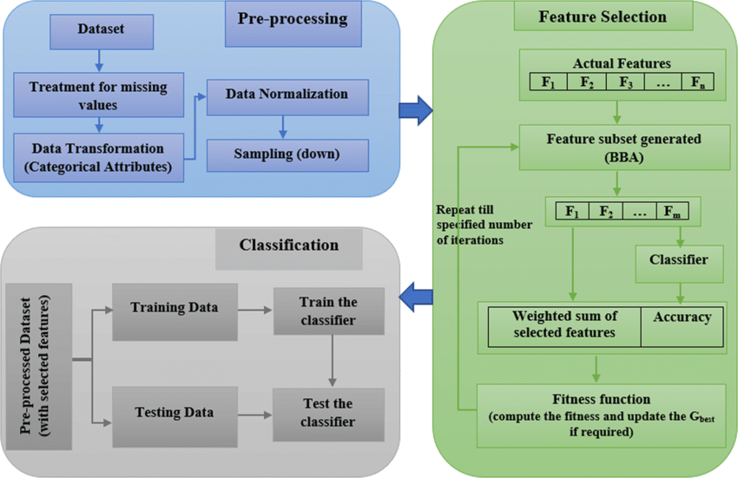
Architecture and Design
The overall architecture of the credit scoring system can be divided into the following layers:
Data Layer: Responsible for collecting, storing, and managing all input data.
Processing Layer: Involves data cleaning, feature extraction, and transformation.
Modeling Layer: Focuses on building and training the ANN model.
Prediction Layer: Delivers real-time credit scoring predictions using the trained ANN model.
Monitoring and Compliance Layer: Ensures ongoing performance monitoring and compliance with legal and ethical standards
Deployment Architecture:
Once the system is designed, it can be deployed using cloud infrastructure, with the following considerations:
Cloud Platforms: Use platforms like AWS, Google Cloud, or Azure to deploy the model with scalability and availability in mind.
Containerization: The use of Docker containers or Kubernetes for deploying the model ensures that the environment is consistent and easily scalable.
Version Control: Using version control for models and data pipelines allows for easy rollback in case of performance issues or updates.

Slide 11





References
"Credit Scoring Using Machine Learning Techniques" by Khandani, Kim, and Lo
This paper discusses how modern machine learning methods can outperform traditional credit scoring models.
"Credit Scoring: Statistical Issues and Challenges" by Lyn Thomas, David Edelman, and Jonathan Crook
Discusses the key statistical challenges in developing credit scoring systems, including data imbalance and feature selection.
"Predicting Credit Risk in Peer-to-Peer Lending: An Empirical Comparison of Machine Learning Methods"by T. Serrano-Cinca, B. Gutiérrez-Nieto
Analyzes the application of machine learning to predict credit risk in the growing peer-to-peer lending market.
Books
"Credit Scoring, Response Modeling, and Insurance Rating: A Practical Guide to Forecasting Consumer Behavior" by Edward Mays
Provides insights into statistical methods and models for credit scoring.
"Credit Risk Modeling using Excel and VBA" by Gunter Löeffler and Peter N. Posch
A hands-on guide to building credit risk models with Excel and VBA, covering practical aspects of model implementation.
"A Comparison of Classifiers for Credit Scoring" by S. Lessmann, B. Baesens, H. Seow, L. C. Thomas
A comprehensive study comparing various machine learning techniques used for credit scoring.

Slide 12

Thank you!

